Slide 1


Refresher Training on the DOH Roll out of UpToDate®
for Government Healthcare Workers
21 March 2024
Evidence Generation and Management Division
Disease Prevention and Control Bureau

Slide 2
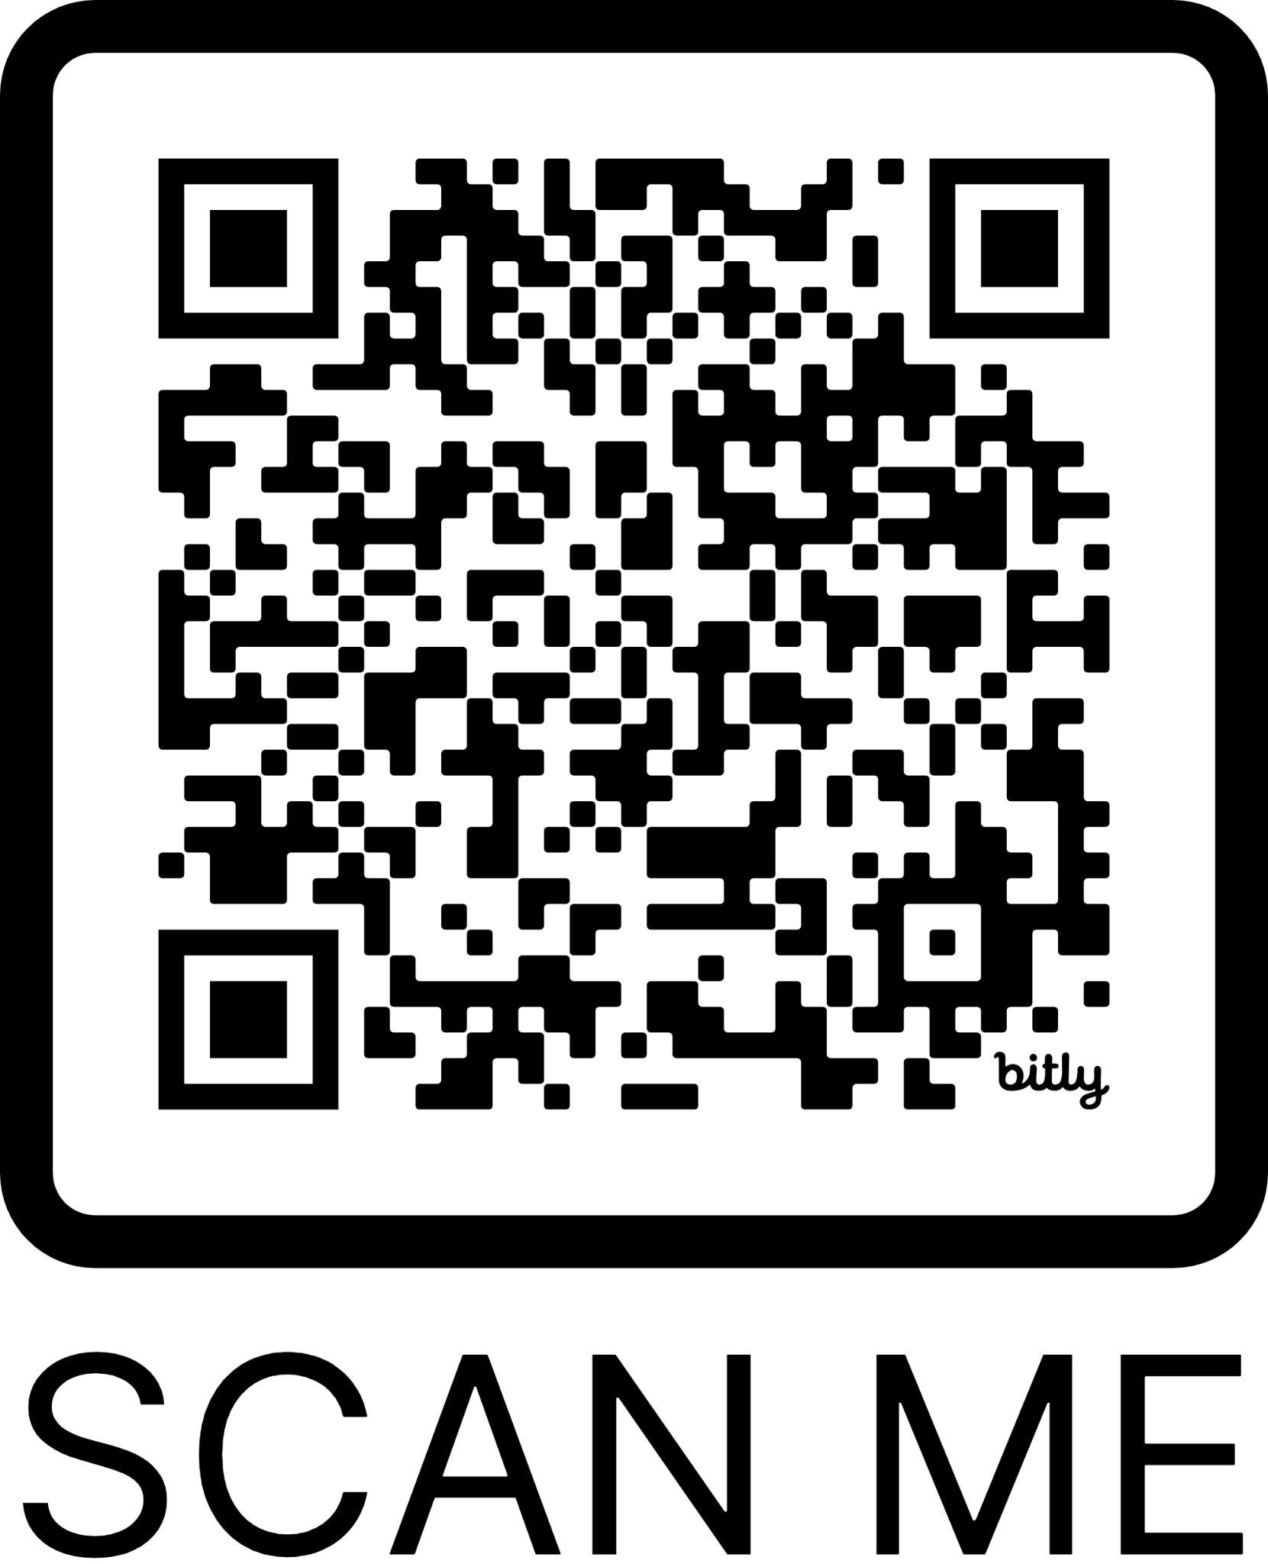

Attendance
Register on the form below or scan the QR Code
https://bit.ly/utdtraining2024

Slide 3
Program of Activities
10:00 AM
Welcome Remarks
Dr. Ruth Divine Agustin, MBA, FPCP, FPCC
Division Chief
Evidence Generation and Management Division (EGMD)
Disease Prevention and Control Bureau
10:05 AM
Overview of the Expanded National Practice Guidelines Program and DOH UpToDate Rollout
Miguel Gaston Agcaoili, RND
Senior Health Program Officer
EGMD-DPCB
10:15 AM
UTD Demonstration
Truong Pham
Customer Success Specialist - Vietnam, Philippines
Wolters Kluwer
10:40 AM
Open Forum
Chelsea Bercasio
Health Program Officer II
EGMD-DPCB
10:50 AM
Closing Remarks
Dr. Jan Derek Junio, MBA, MPH, RND
Medical Officer IV
EGMD-DPCB
10:55 AM
CSS Form Evaluation

Slide 4
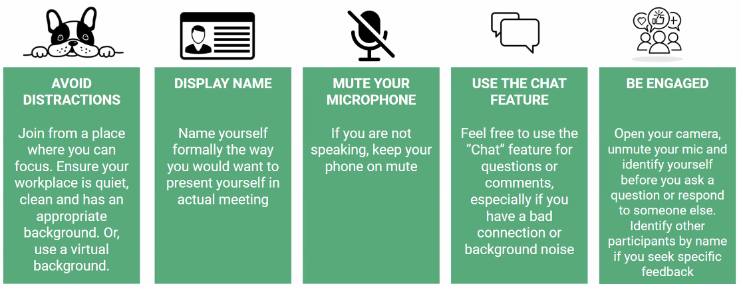
Virtual Training Rules:

Slide 5
Welcome Remarks
Dr. Ruth Divine Agustin, MBA, FPCP, FPCC
Division Chief
Evidence Generation and Management Division
Disease Prevention and Control Bureau
Notes:
Welcome everyone (previous and new users) to the refresher training session for the UpToDate App, an evidence-based clinical support tool designed to assist all of you, government healthcare workers, particularly primary care and secondary care physicians, in their daily practice.
The primary objective of this training session is to refresh your proficiency in navigating and utilizing the features of the UpToDate App effectively. We want to ensure and help you maximize the benefits of the UpToDate app which will enhance your clinical decision-making and ultimately improving patient care outcomes
This is part of the DPCB and the DOH's commitment to support healthcare workers by providing access to innovative clinical support tools like the UpToDate App.
We started rolling this App to complement and supplement the standards of care (Omnibus Health Guidelines, DOH-Approved CPGs, and Interim Public Health Guidelines) in our National Practice Guidelines program, serving as a valuable resource for healthcare professionals in their day-to-day practice.
In this era of infodemic, evidence-based medicine and clinical decision support tools are critical in delivering high-quality patient care.
We strive to assist you on informed clinical decision-making and improving service delivery by providing access to the latest research findings, guidelines, and best practices.
By the end of this training we aim:
to refresh users' knowledge of basic navigation and functionality of the UpToDate App.
to demonstrate advanced search techniques to optimize information retrieval.
to provide virtual navigation techniques to reinforce learning and address any questions or concerns.
We encourage your active participation and engagement throughout the training session to maximize the learning experience and ensure proficiency in utilizing the UpToDate App.
Again, on behalf of our DPCB Director, Dir. Celine Garfin, we extend our appreciation to our government healthcare workers for your commitment to the realization of Universal Healthcare.
Rest asssured that the DOH will continue supporting healthcare workers in their efforts to deliver high-quality patient care.
By the end of this training, we hope that you will apply the knowledge and skills gained from the training session in your daily clinical practice, thereby maximizing the benefits of the UpToDate App and ultimately improving patient outcomes.
Maraming salamat at magandang umaga sa ating lahat!

Slide 6
Overview of the DOH
National Practice Guidelines Program
Miguel Gaston M. Agcaoili, RND
Senior Health Program Officer
Evidence Generation and Management Division
Disease Prevention and Control Bureau
Notes:
Magandang umaga po sa lahat ng ating healthcare workers na nakikinig ngayon. Maraming salamat po for giving your time to listen in on our refresher training this morning. But before we proceed with the refresher training, let me provide a very brief overview of the National Practice Guidelines Program.

Slide 7
The Expanded NPGP Framework
Different sub-activities ensure continuity and comprehensiveness of standards development, included in the Expanded NPGP Framework
Dissemination
Utilization in Policy & Decision Making
Information Sources
Quality Appraisal
Standards Setting
Online means (CPG repository, website, mobile app)
Facilitation for HTA, PHIC, FDA
Print format (compendium, manuscripts, summaries)
Local and Global Policy, Interagency Agenda, Position Papers, Etc.
Presentations in fora
Policies on Service Delivery Standards for HCWs and Facilities
Local CPGs or Guidance Documents
CPG Consensus Panels
DOH-approved Clinical Practice Guidelines
Monitoring and Evaluation
Cascading in Media Fora, Townhalls, NGAs
Local Primary Researches
CPG Quality Review
Omnibus Health Guidelines
Implementation Support for Service Delivery
Practice Surveys
Expert Position Papers from Societies
Lifestage TWGs
Quality Assurance and Certifications
In-house review of International Research & Guidance Documents
DOH EREID TWG
Interim Guidance for EREID and PHE
Clinician Support Tools
Capacity Building for HCWs
Performance Scorecards
Internal Quality Assurance
Patient Support Tools
Capacity Building for Implementers
Quality Indicators and Disease Outcomes Data
Settings-Specific Tools
Supportive Supervision Strategies
Conflict of Interest Management, Transparency, Capacity Strengthening, Networking and Partnerships Management
Notes:
The National Practice Guidelines Program was developed in 2023 to provide a mechanism to promote evidence-based decision making in health care. Specifically,
The program utilizes information sources which are deemed high-quality after appraisal or vetting from our local experts.
These information sources are then translated into standards or what we call the National Practice Guidelines which are the DOH-approved Clinical Practice Guidelines Program, Omnibus Health Guidelines, and Interim Public Health and Clinical Guidance for Emerging and Re-emerging Infectious Diseases and Public Health Emergencies.
To ensure that our National Practice Guidelines are utilized by our healthcare professionals and policymakers, the Program employs different dissemination methods
The National Practice Guidelines may also be used for benefit package development and local and national decision-making
To effectively execute the service delivery standards from these guidelines, different implementation tools are to be developed such as the clinician, patient, and settings-specific tools and capacity-building activities
Monitoring and evaluation of the National Practice Guidelines and processes of the Program will also be performed to continuously improve and reach the intended goals of the Program
Throughout this framework, the principles of COI management, transparency, capacity strengthening, networking, and partnerships management are upheld

Slide 8
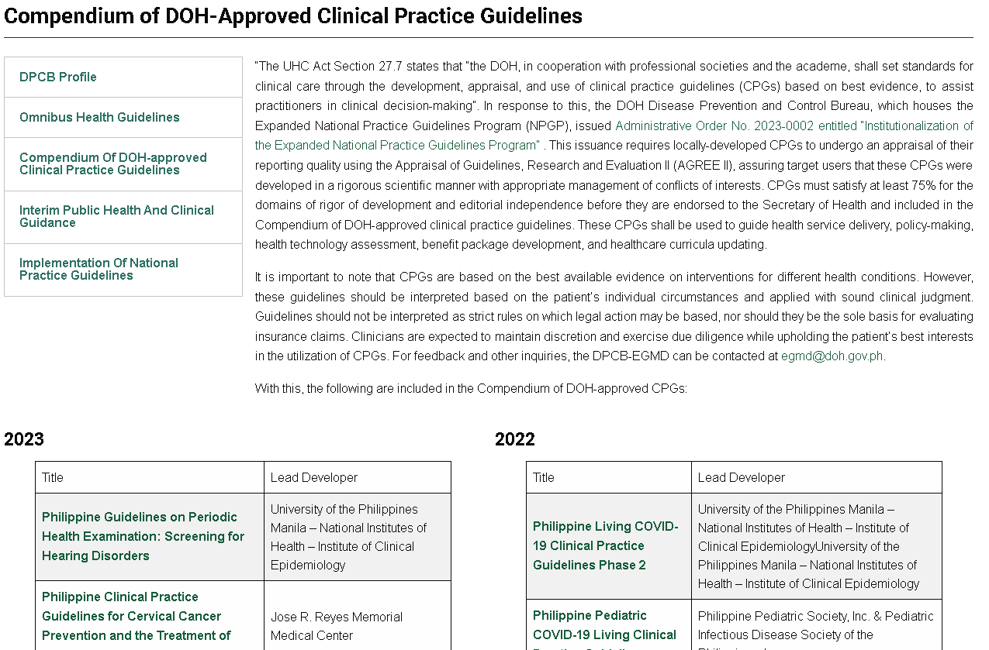
National Practice Guidelines
Expanded NPGP products are publicly available and easily accessible to all
Completed and DOH-Approved (n=56) |  | For development, 2024 (n=6)
Chronic Obstructive Pulmonary Disease Dengue Gastric Cancer and H. Pylori-associated Diseases Palliative and End-of-Life Care for Adult Cancer Patients Cervical Cancer Obesity Contact Dermatitis Abnormal Cervical Cancer Screening Results Acute Infectious Diarrhea Acute Myeloid Leukemia Acute Myeloid Leukemia Adult and Neonatal Sepsis Breast Cancer Burkitt Lymphoma COVID-19 Colorectal Cancer Diffuse Large B-Cell Lymphoma Gastric Cancer Dyslipidemia Hemodialysis Hepatitis B Hepatocellular Carcinoma Hypertension Nicotine Dependence Pediatric Asthma | Palliative and End-of-Life Care for Cancer Patients Pediatric Community-Acquired Pneumonia Pediatric and Adult Immunization Periodic Health Examination Prostate Cancer Stroke Well-Differentiated Thyroid Cancer Adult immunizations Chronic obstructive pulmonary disease Common dermatologic conditions Dengue Hearing disorders screening Heart failure Infectious diseases screening Musculoskeletal disorders screening Oral, head, and neck cancer Overweight and obesity Pediatric immunizations Prenatal disorders screening Renal, metabolic, and nutritional screening Urinary tract infection Vision disorders screening Wilms tumor Isolated Mandibular Fracture Leprosy Lifestyle Advice Low Back Pain Lung Carcinoma Hyperthyroidism | Animal bite Asthma COVID, EREID, and other Outbreak-Prone Diseases HIV Substance Use Disorders
Compendium of DOH-approved Clinical Practice Guidelines
www.doh.gov.ph/dpcb/doh-approved-cpg
Notes:
Since inception of Program, we have released the compendium of DOH-approved CPGs which already has 56 high-quality CPGs. 6 CPGs will be developed this year in partnership with the University of the Philippines Manila - National Institutes of Health and various medical societies and hospitals.

Slide 9
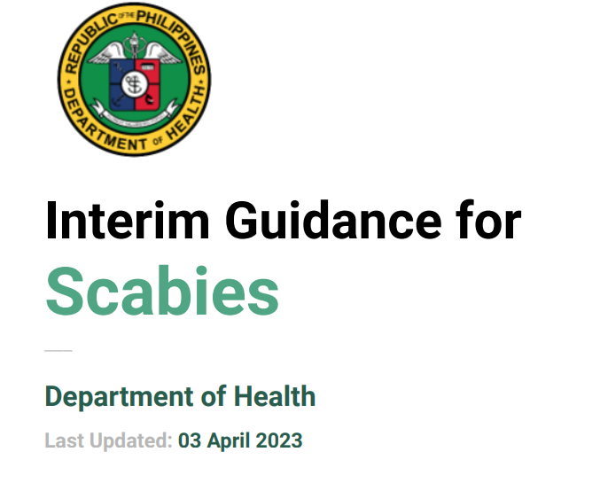
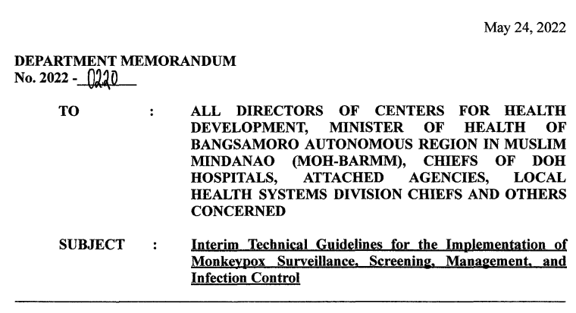
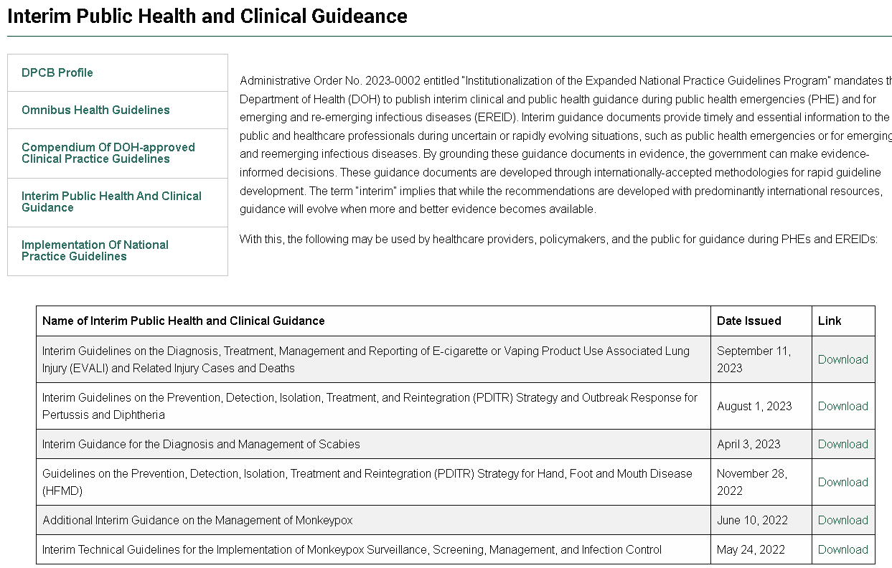
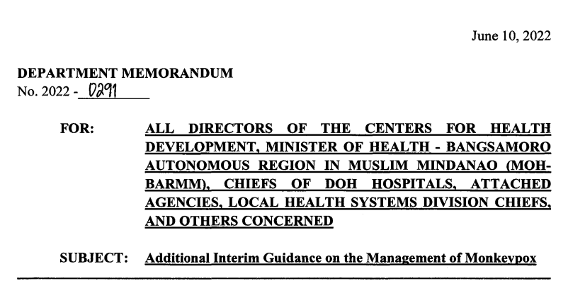
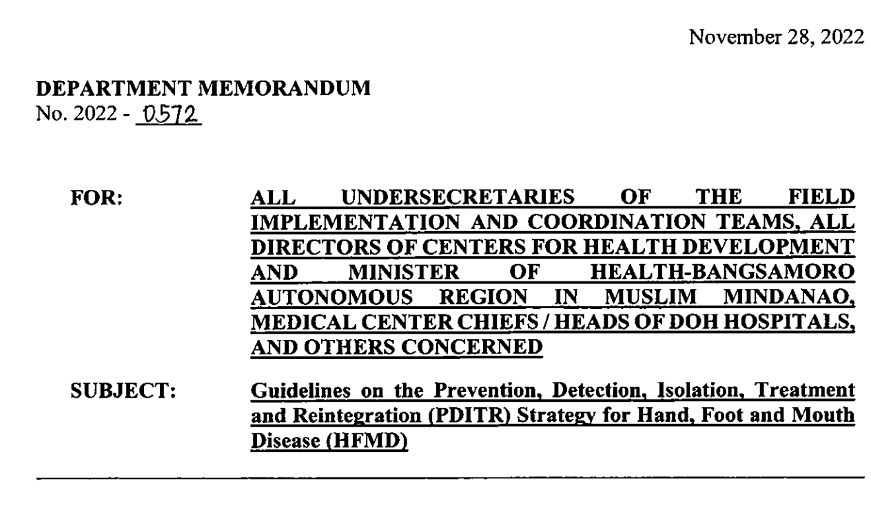
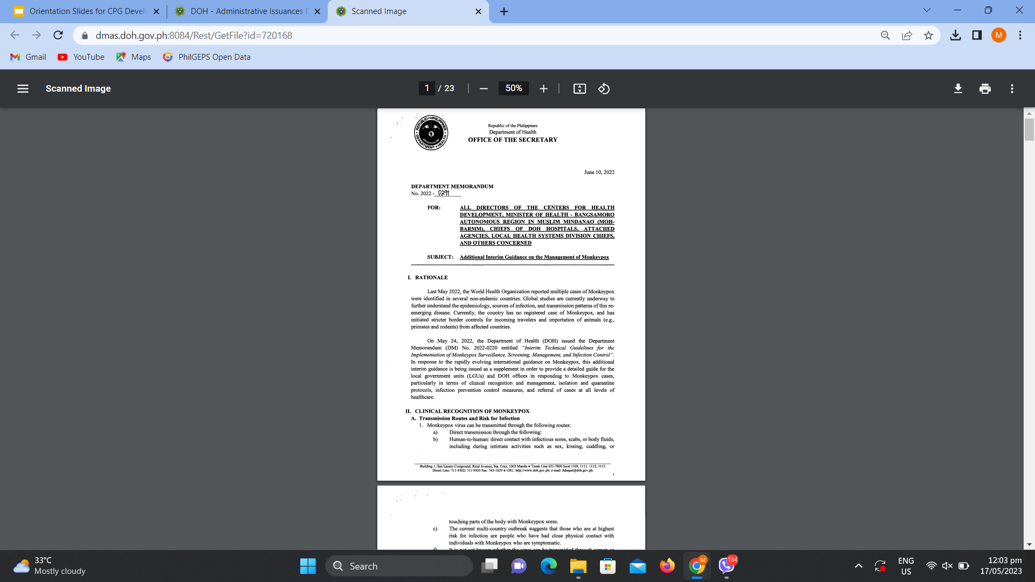
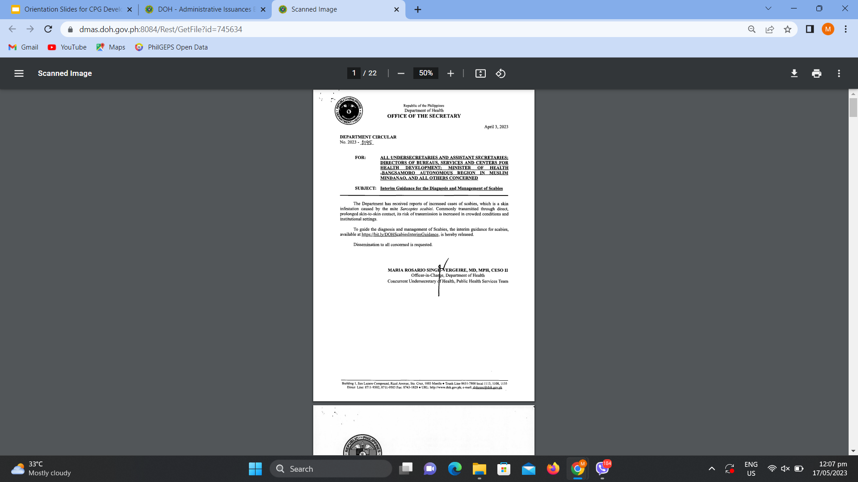
National Practice Guidelines
Expanded NPGP products are publicly available and easily accessible to all
Interim Clinical and Public Health Guidance
www.doh.gov.ph/dpcb/interim-guidance
Notes:
Another guidance document in the NPGP is the Interim Clinical and Public Health Guidance. This is a guidance document more specifically developed for use during or in the emergence of public health emergencies (PHE) and for emerging and re-emerging infectious diseases (EREID).
Currently, the DOH has developed interim guidance on ILI, monkeypox, scabies, HFMD, pertussis+diphtheria, and e-cigarette or vaping product use associated lung injury.

Slide 10
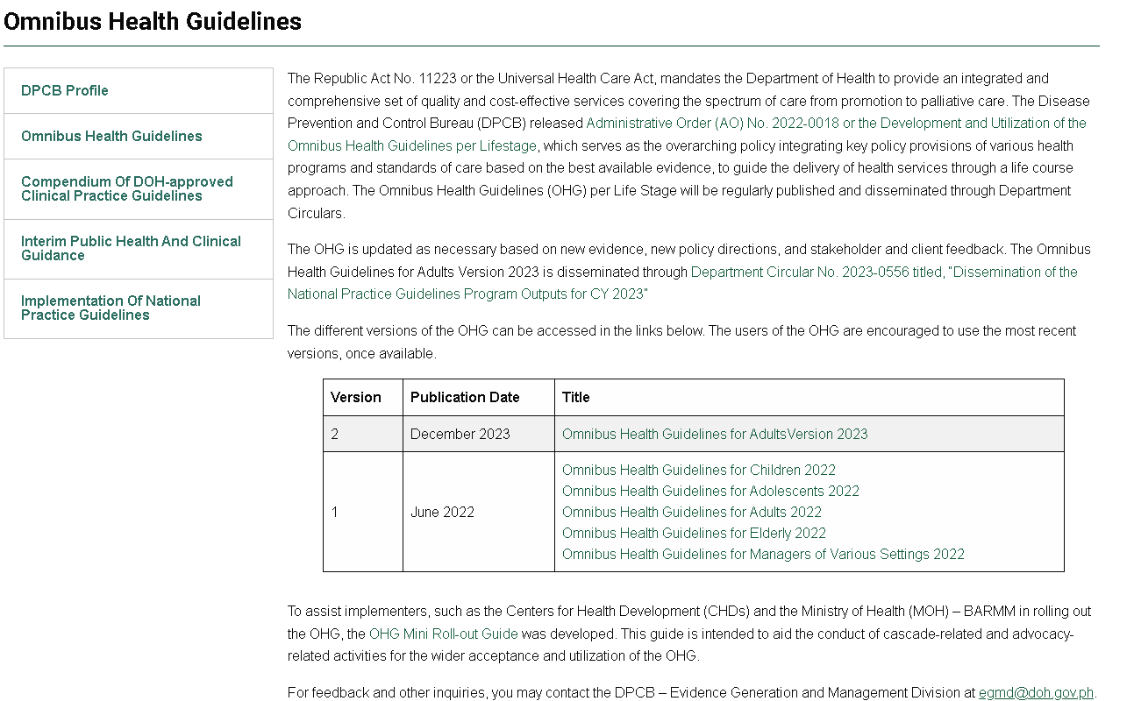
The Omnibus Health Guidelines consolidates primary care standards, shifting from fragmented to integrated guidelines for each life stage.
Administrative Order 2022-0018
Omnibus Health Guidelines
www.doh.gov.ph/dpcb/omnibus-health-guidelines
OHG for Children
Self and Household Care
OHG for Adolescents & Reproductive Age
Screening (Well/Asymptomatic)
Annexes
OHG for Adults
Diagnostics
(Sick/Symptomatic)
OHG for the Elderly
Treatment
OHG for Managers of Various Settings
Rehabilitation
Palliative Care
Notes:
To address the gaps in integrated health service standards, the Omnibus Health Guidelines (or OHG) serves as the main policy reference to fulfill the mandate of DOH in achieving technical integration and quality services.
In Administrative Order 2022-0018, the OHG defines the standards of care for child, adolescent, adults, elderly. It also include standards on governance, service delivery, linkages, and participation in health promotion among various settings such as learning institutions, workplaces, and closed settings.
The OHG contain provisions on health promotion, self and household care, screening, diagnosis, treatment, and rehabilitation and palliative care.

Slide 11
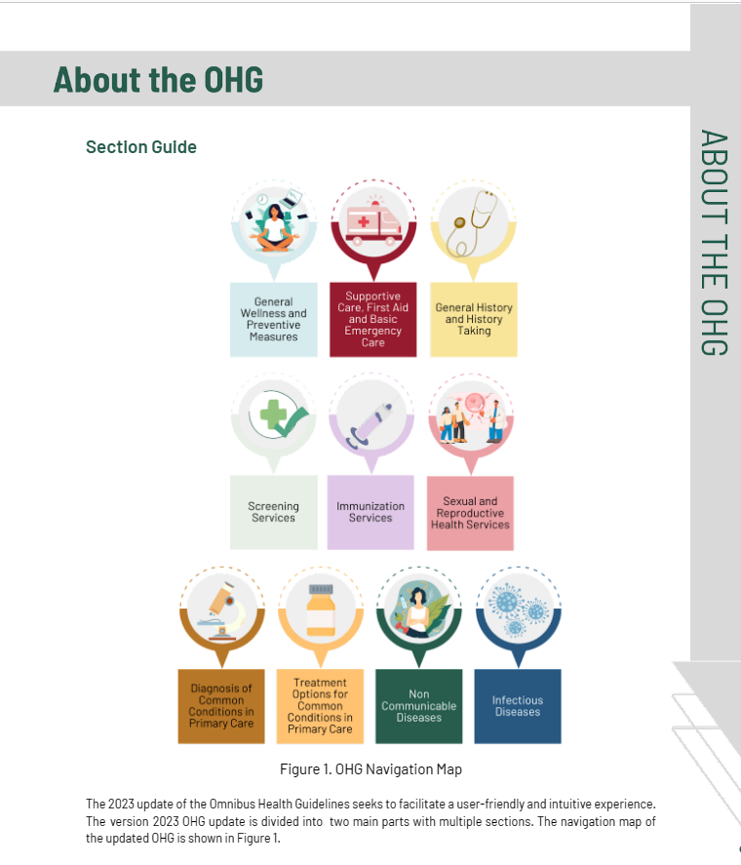
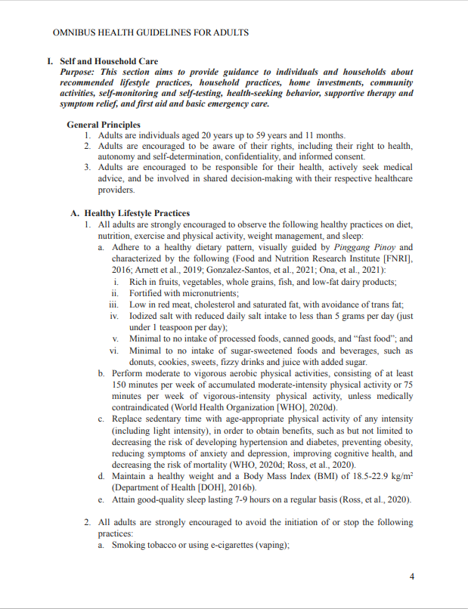
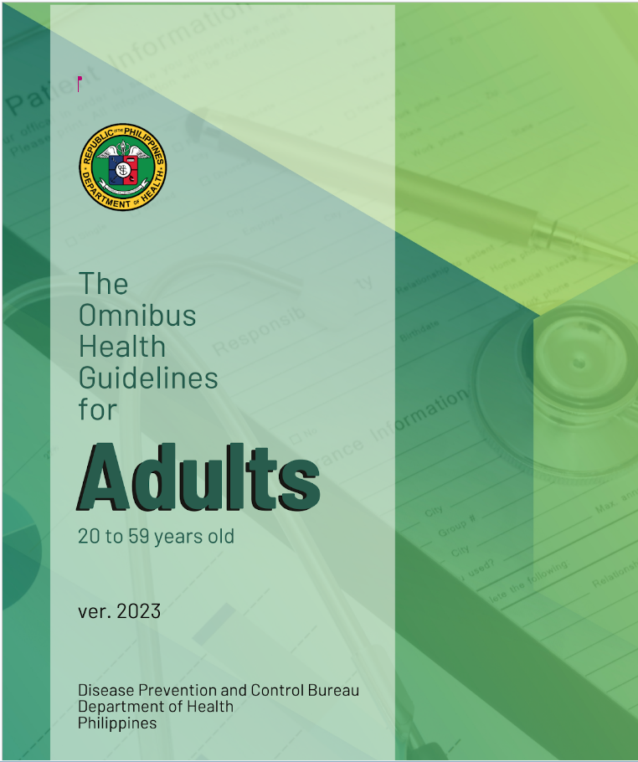
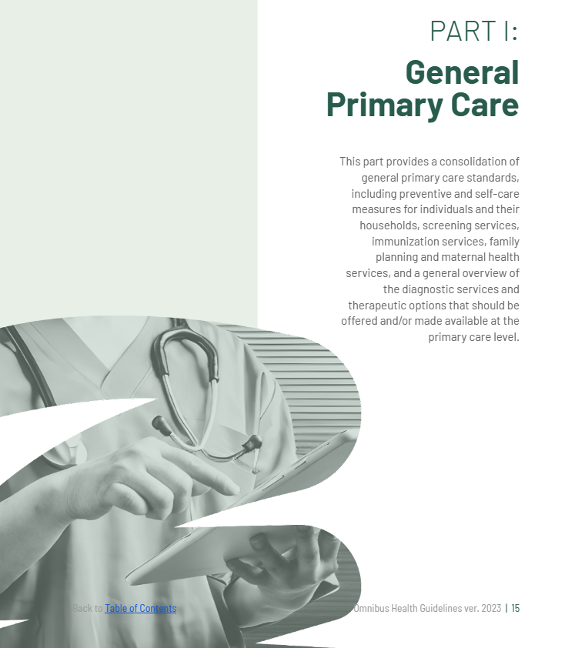
OHG Version 2022
OHG Version 2023
www.doh.gov.ph/dpcb/omnibus-health-guidelines
Notes:
We have received feedback from different stakeholders on the format and content of the OHG version 2022. Recently, we have released the OHG for Adults version 2023 which has
Clickable links to sections, reference documents, relevant tools, and others materials.
Updated content to reflect evidence-based standards of care for key priority programs of the DOH
Stylized from previously black and white document

Slide 12
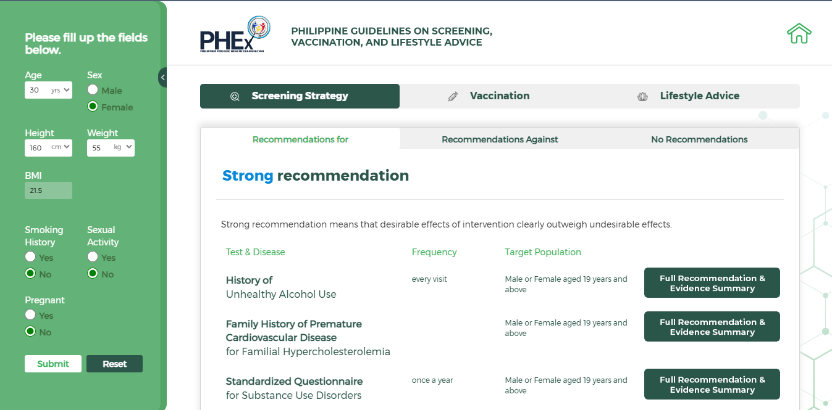
National Practice Guidelines
Guideline Implementation Tools are being created for the implementation of the Expanded NPGP products
PHEX App on Primary Care Screening, Vaccination, and Lifestyle Advice
phex.ph
Notes:
A web application on primary care screening, vaccination, and lifestyle advice referencing the Philippine Guidelines for Health Examination may be accessed on the links on the screen. Tools for patients, implementers, and evaluators are to be developed in the future.

Slide 13
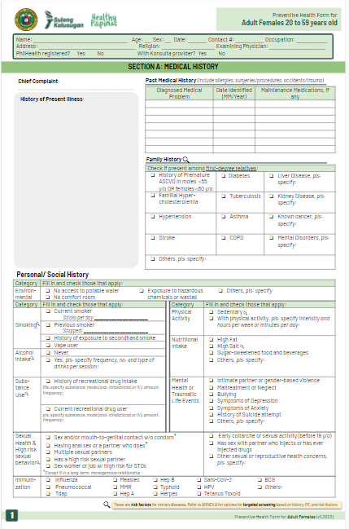
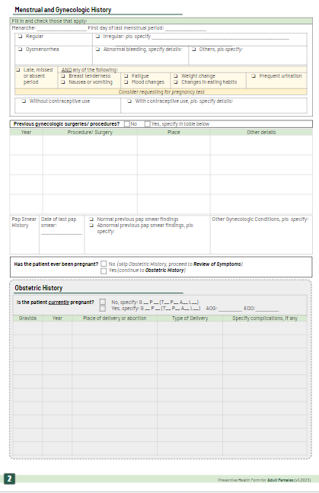
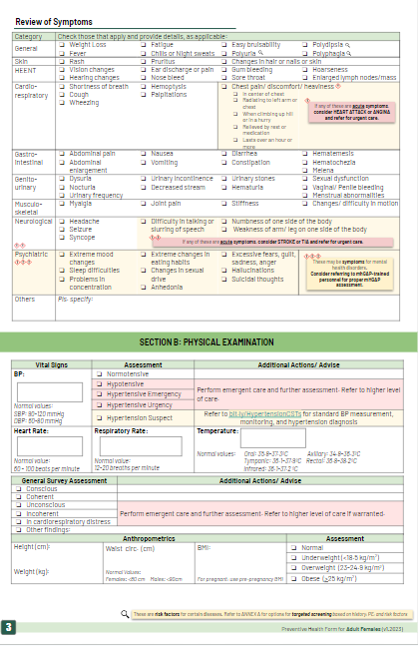
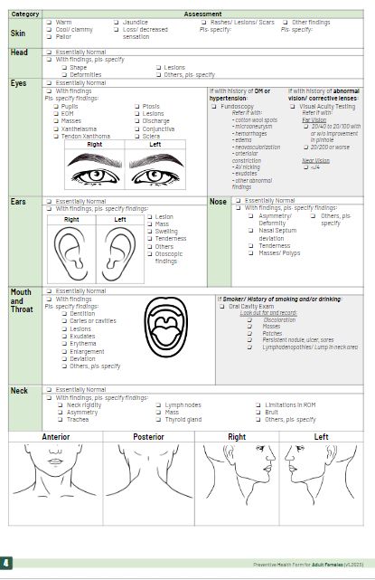
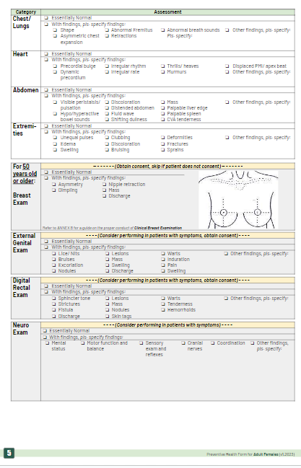
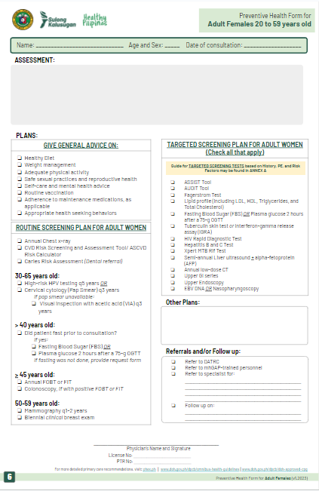
HEALTH EXAMINATION FORMS
Standardize the medical record and facilitate opportunistic screening of all priority programs and top primary care conditions
Fields tailored for each life stage based on standards in the OHG and other NPGs
With trigger/prompts to guide the patient encounter during hx/pe (clinical decision support)
Separate sections can be done different members of the primary care team (task sharing between cadres)
Patient Information
Screening for Red Flags
Medical History
Review of Systems
Physical Examination
Assessment
Plans
Annexes
https://doh.gov.ph/dpcb/implementation-of-national-practice-guidelines/
Notes:
The Health Examination Forms are developed to standardize the medical record and faciliate opportunistic screening of all priority programs and top primary care conditions. It includes fields tailored for each lifestage based on standards in the OHG and other NPGs. It also has trigger/prompts to guide the patient encounter during history taking and physical examination, and separate sections can be done among different members of the primary care team to promote task sharing between cadres.
The Health Examination Forms have sections on patient information, screening for red flags, medical history, review of systems, physical examination, assessment, plans, and relevant annexes to further guide healthcare professionals.

Slide 14
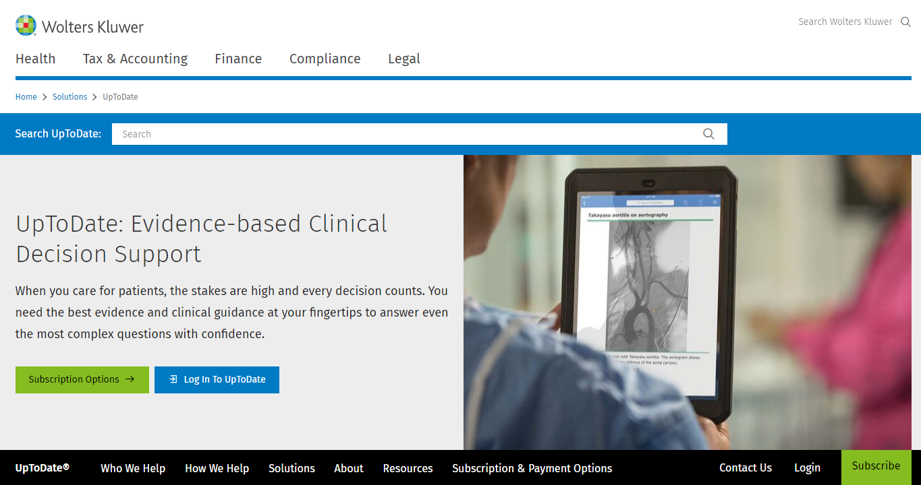
What is UpToDateⓇ?
Notes:
Another type of clinician support tool is the UpToDate. UpToDate delivers evidence-based clinical decision support that synthesizes available clinical evidence and clinical practices to help our government healthcare workers make appropriate care decisions and drive better outcomes for high-quality patient care.

Slide 15
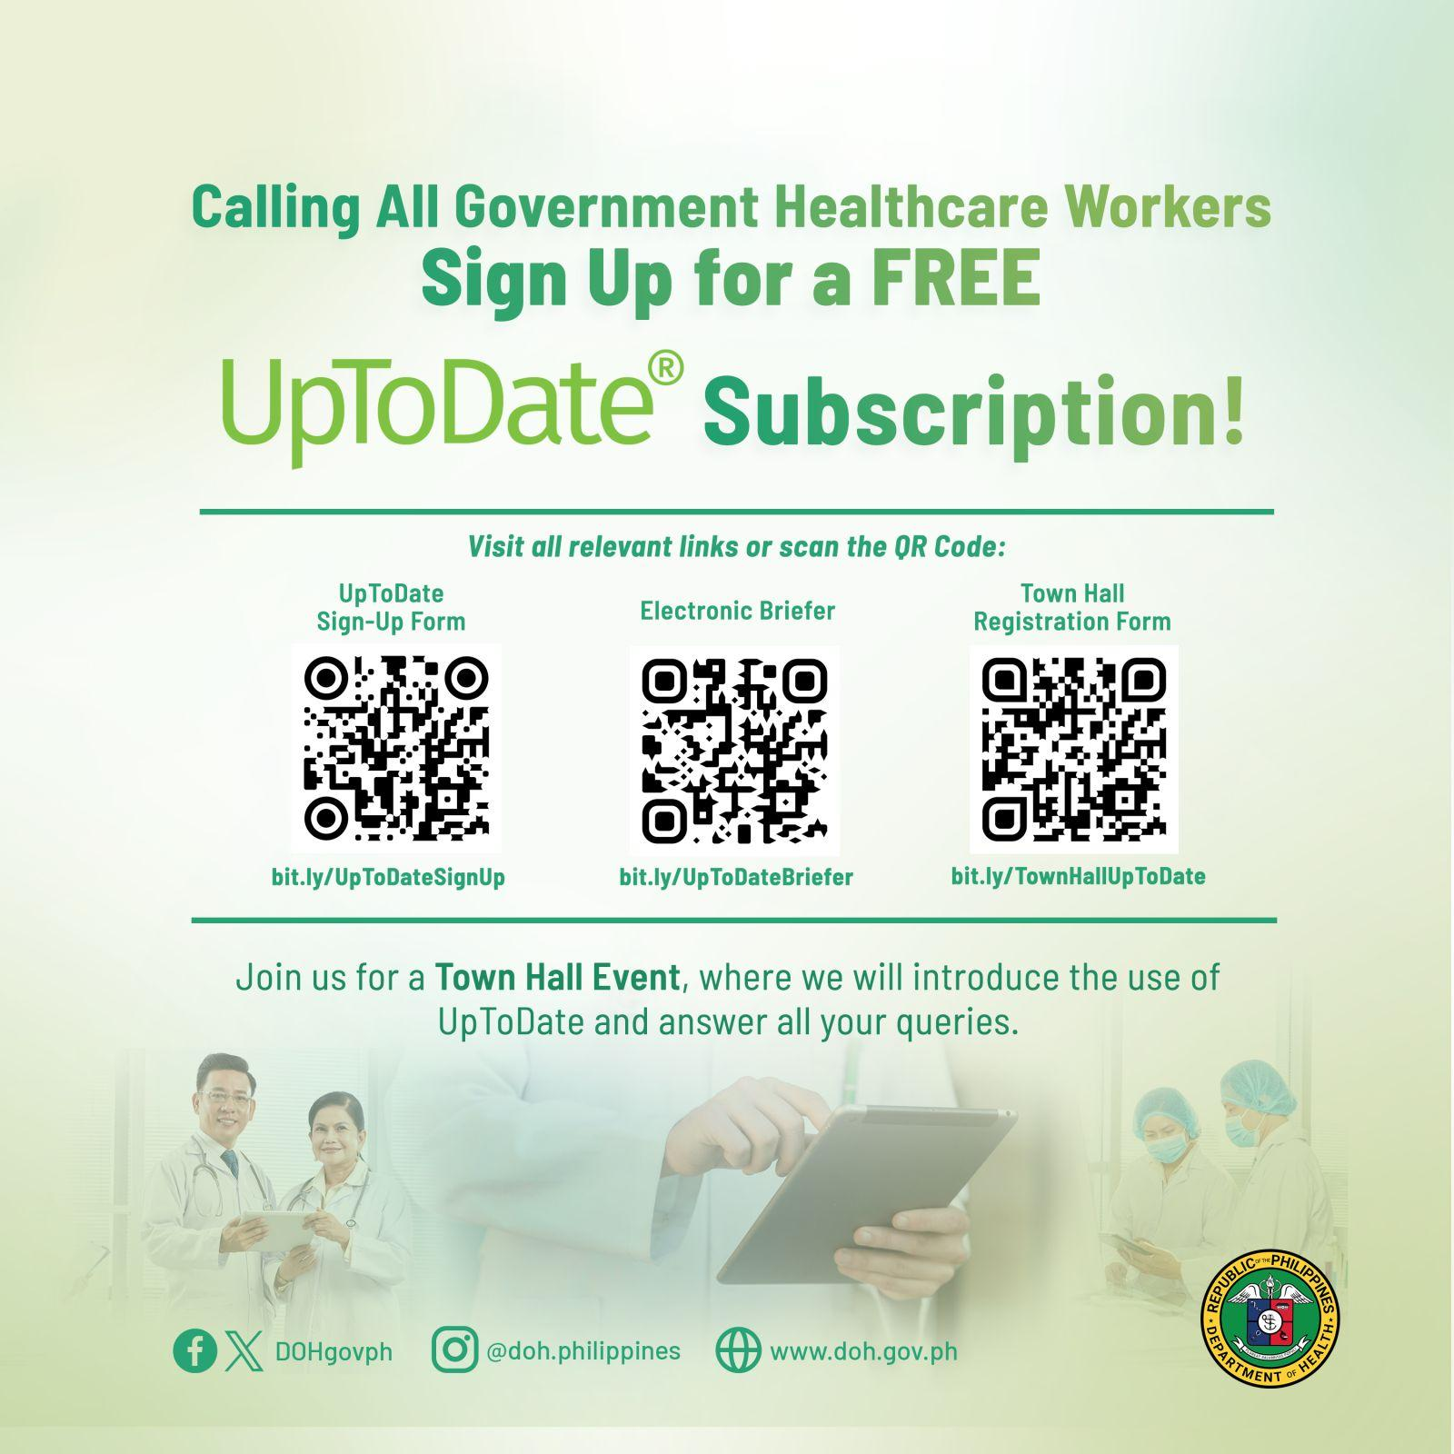
UpToDate Registration
(For Government Healthcare Workers)
START
Legend:
Green - DPCB EGMD
Yellow - Healthcare Worker
Signed-up?
NO
Provide feedback
YES
ASSISTED REGISTRATION BY DOH-DPCB thru EGMD
Create invitation using the Subscription Manager
Account registration
END
Sign-up sheet is accessible at: bit.ly/UpToDateSignUp
Notes:
To provide you with UpToDate access, kindly accomplish the sign-up sheet by scanning the QR code on your screen or by visiting bit.ly/UpToDateSignUp. The team will screen the submission for eligibility prior to accounts creation. Once approved by our team, the UpToDate will email you the instructions for the UpToDate registration.

Slide 16

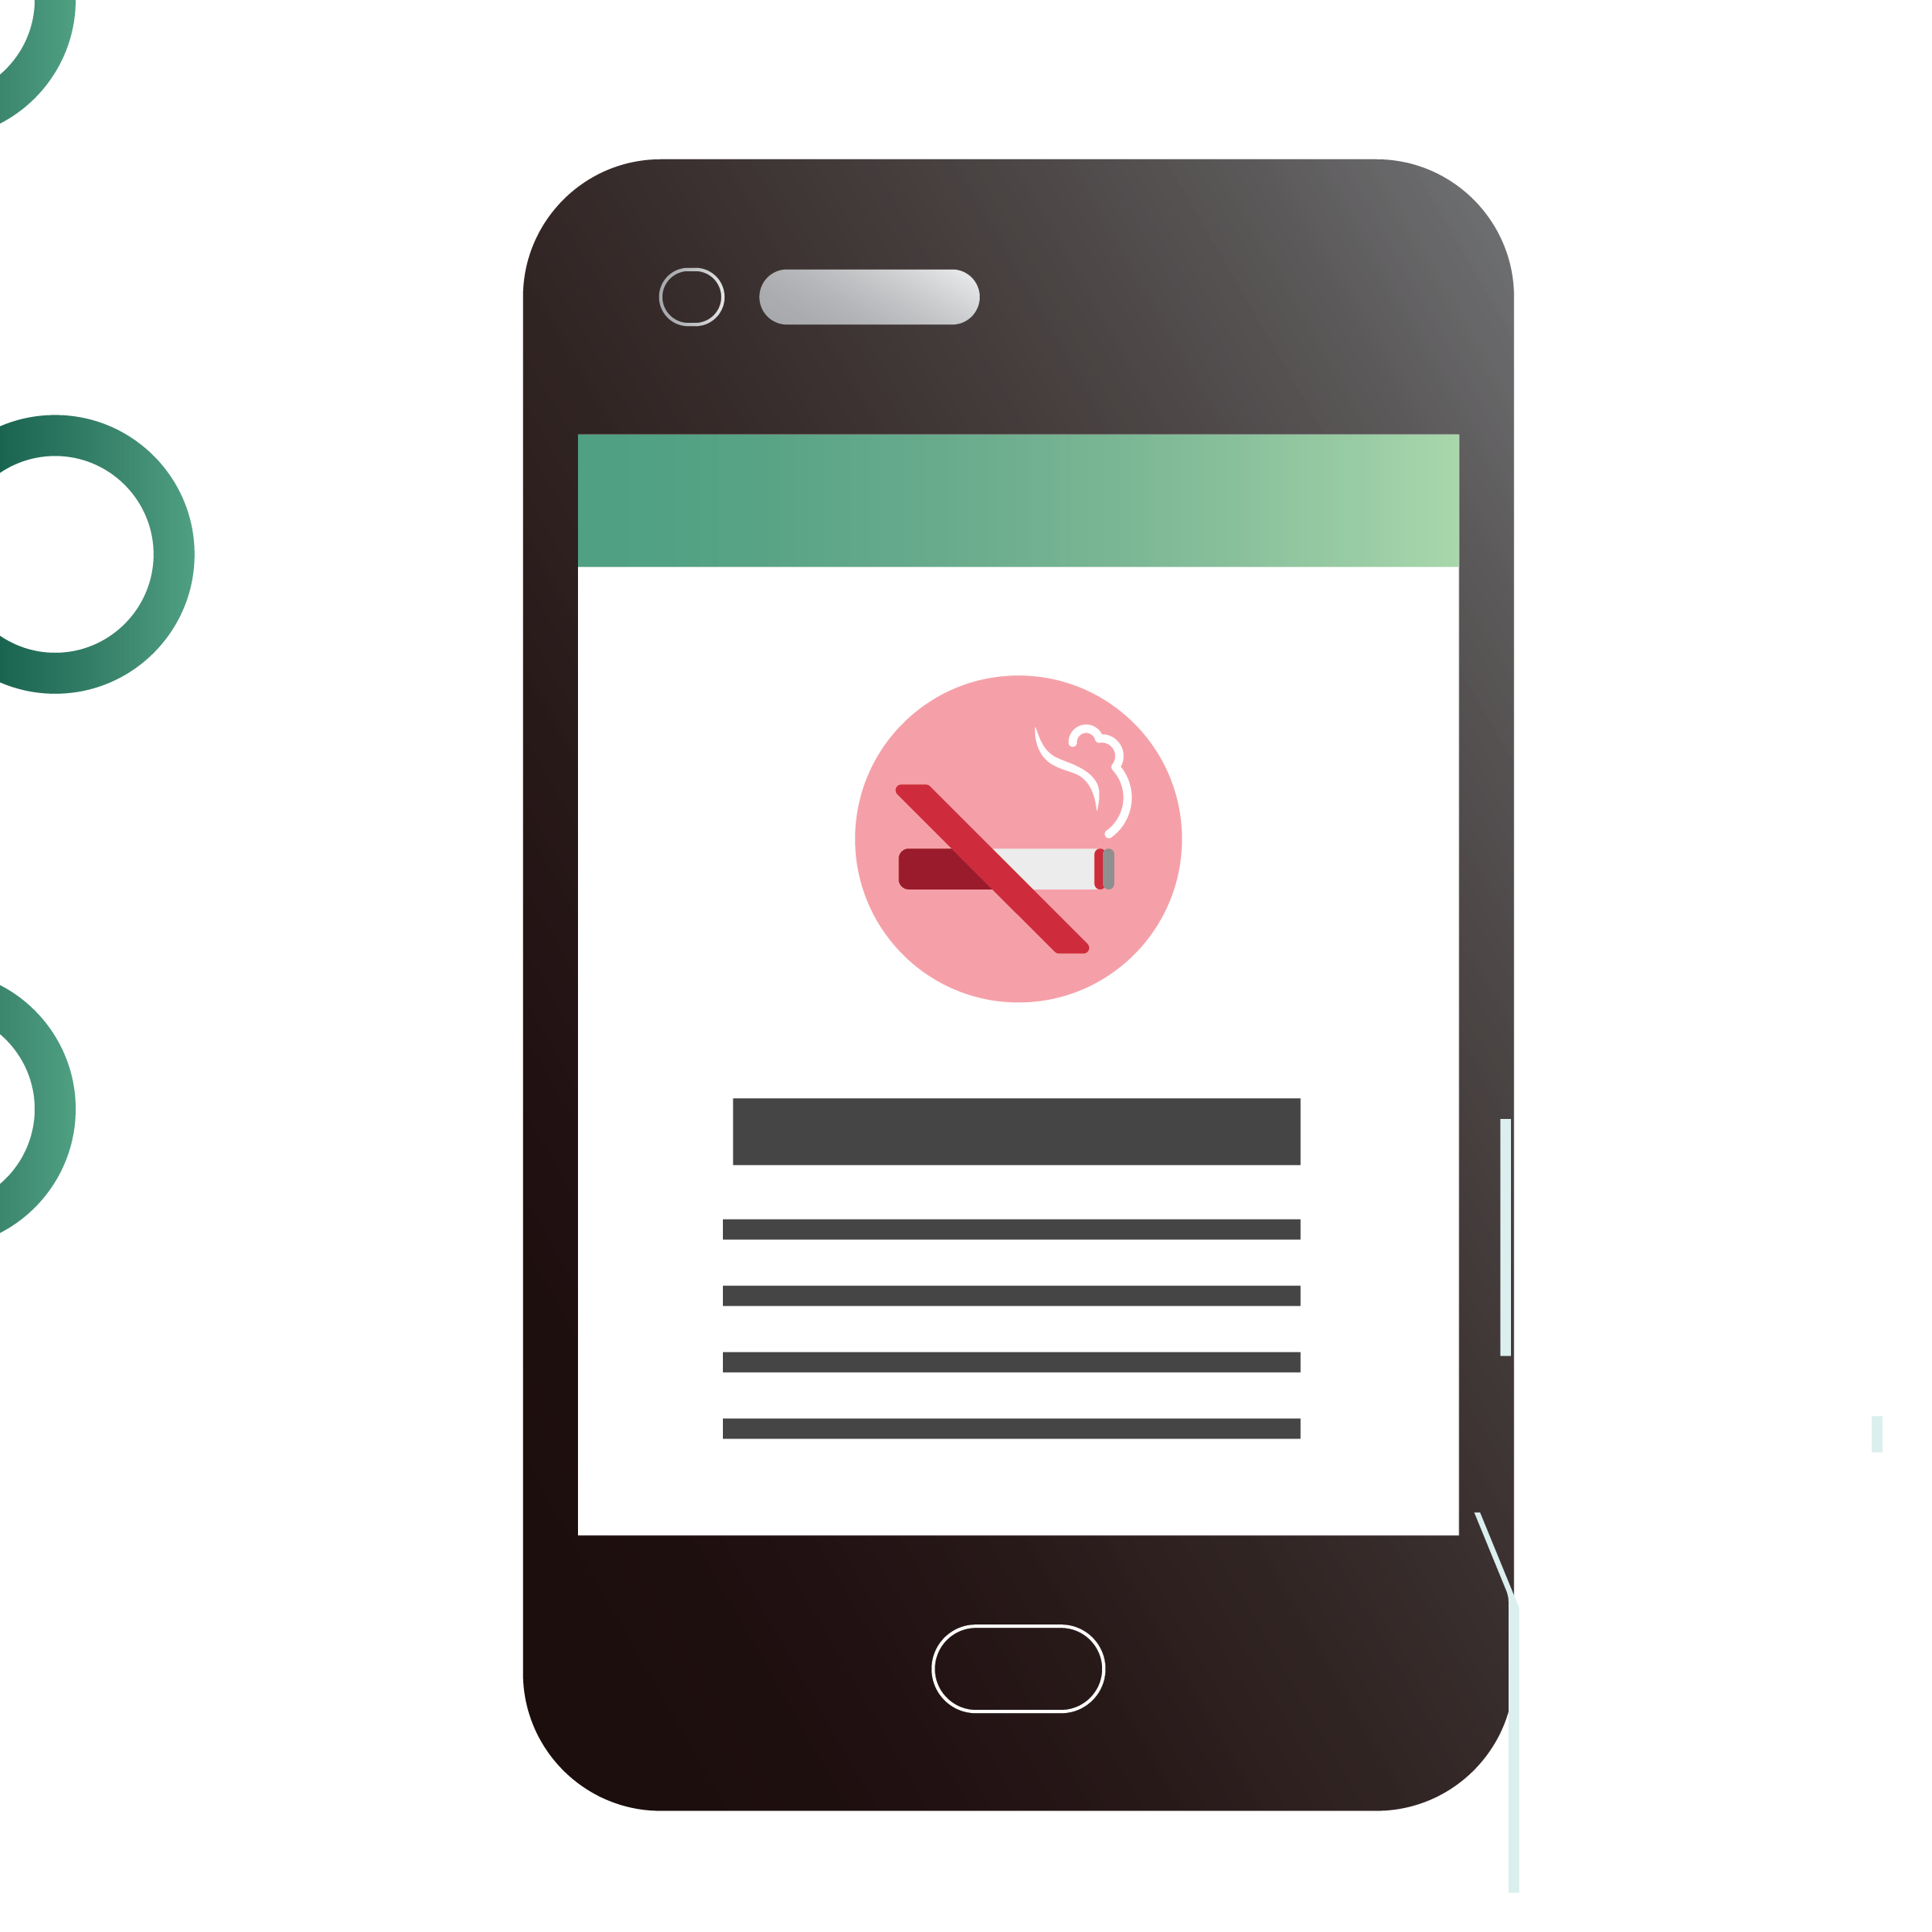






What will be made available?
One year 24/7 full access* to the databases
*remote access through username and password
Abstracts of medical articles cited in UpToDate
Monographs, practice guidelines, clinical studies
Customizable patient education materials/ handouts
Multimedia resources
(procedural videos, high-resolution images, etc.)
Notes:
Once you have you UpToDate accounts, you will be provided one year 24/7 full access to the databases including abstracts of medical articles cited in UpToDate, monographs, practice guidelines, clinical studies, customizable patient education materials/handouts, multimedia resources such as procedural videos, high-resolution images, etc.
Last year, we have provided UpToDate access among 700 doctors to the barrios and now we are expanding to provide access among our government healthcare workers.

Slide 17


Ideal use of National Practice Guidelines during a Primary Care Visit
OHG
(what - policy)
CSTs
(how)
e.g. clinical pathways, case management protocols, algorithms, etc.
Well/ Asymptomatic patient
CPG
(why)
Symptoms based
Disease-specific
UpToDate
(supplement)
UpToDate
(supplement)
BEFORE patient encounter
Patient comes in
DURING patient encounter
NPGs
www.doh.gov.ph/dpcb/doh-approved-cpg
www.doh.gov.ph/dpcb/omnibus-health-guidelines
www.doh.gov.ph/interim-guidance
Notes:
How will UpToDate supplement our National Practice Guidelines before and during patient encounter? Healthcare professionals are expected to know WHAT primary care standards to be offered among their patients through a review of the Omnibus Health Guidelines. To know why these primary care standards are offered, healthcare professionals are expected to have reviewed CPGs, esspecially our DOH-approved CPGs. UpToDate may supplement the Omnibus Health Guidelines and DOH-approved CPGs if there are still identified gaps from the aforementioned references. When the patient comes in, the healthcare professionals may use clinician support tools and UpToDate to guide them during their patient encounter.

Slide 18
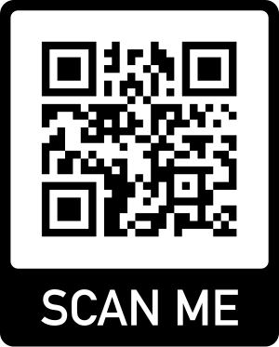
Maraming Salamat po!
We appreciate your feedback:
https://bit.ly/CSMSurveyTool

Slide 19
Up-To-Date Demonstration
Truong Pham
Customer Success Specialist - Vietnam, Philippines
Wolters Kluwer

Slide 20
Open Forum
Chelsea Danica E. Bercasio
Health Program Officer II
Evidence Generation and Management Division
Disease Prevention and Control Bureau

Slide 21
Closing Remarks
Dr. Jan Derek D. Junio, MBA, MPH, RND
Medical Officer IV
Evidence Generation and Management Division
Disease Prevention and Control Bureau

Slide 22

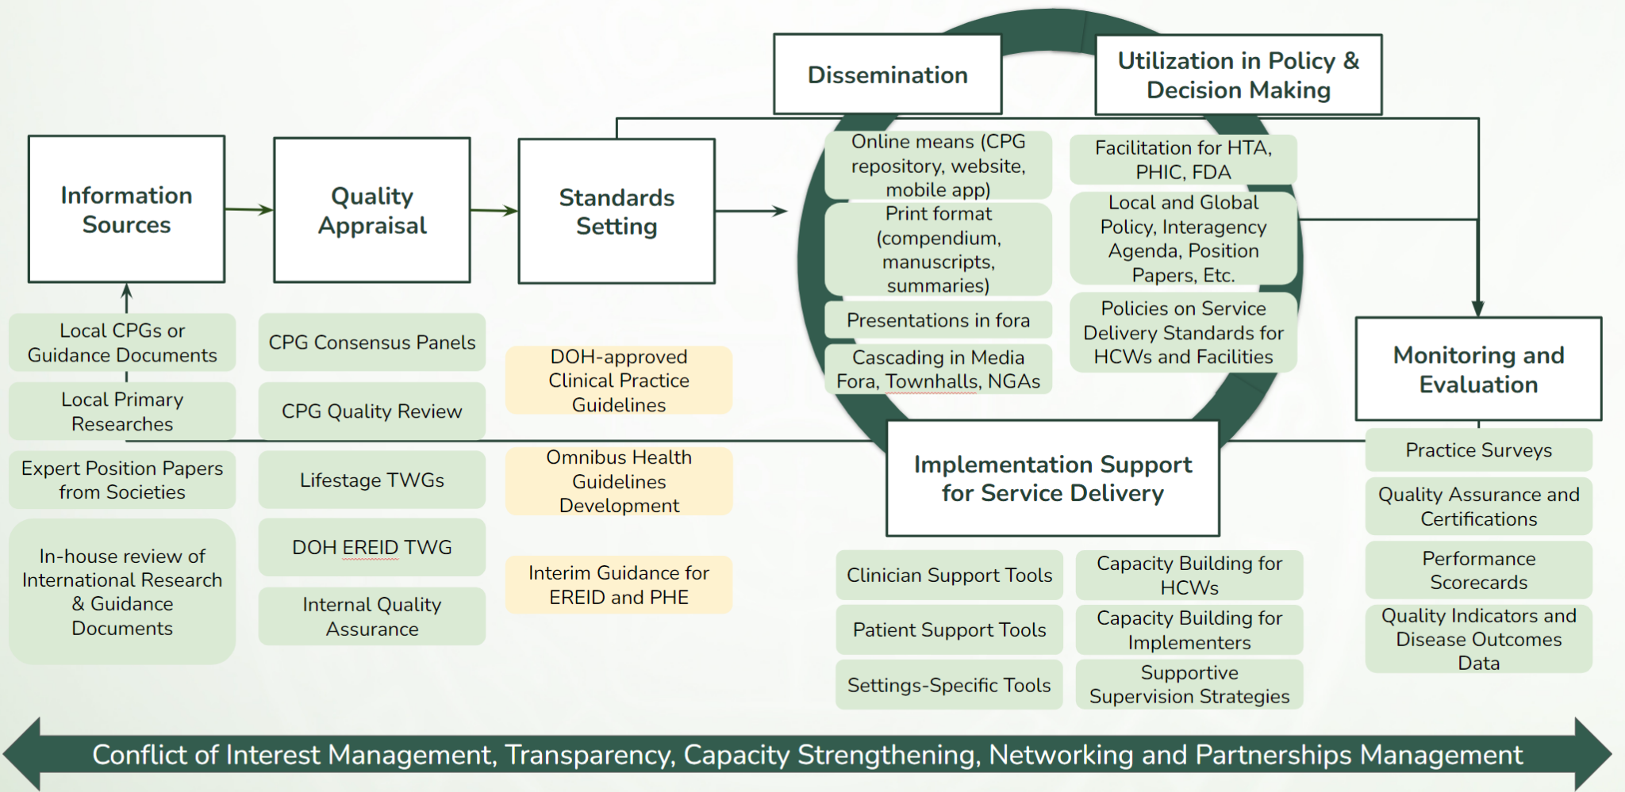
For feedback and inquiries, contact us at:
egmd@doh.gov.ph
uptodate@doh.gov.ph
Collective and coordinated action at all levels towards EVIDENCE-BASED and
universal health care!
Health Care Providers
Centers for Health Dev’t
DOH Central
Office
Notes:
Through our collective and coordinated action, we can ensure evidence-based and universal health care for the Filipino people.

Slide 23
Maraming Salamat po!
We appreciate your feedback:
https://bit.ly/CSMSurveyTool

